Slide 1
Improving The Algorithmic Efficiency And Expert Collaboration
Of A Data Annotation Web Application
03.06.2024
Majd Alkayyal - Application Project Kickoff

Slide 2
Outline
CreateData4AI Background
Problems
  Exploration Areas
  Current Progress
Project Timeline

Slide 3

CD4AI Background
It bridges the gap between unstructured datasets and annotated datasets by allowing users to annotate their own textual data using user-defined classes.
How does it work?
Text
Text
upload
Text
Keyword Extraction
Context Window Extraction
Extrapolation
Text 1
Text 0
Text 1
Text 1
Text 0
Text 1
Text 1
Text 0
Text 1
define
Classes
Job Descriptions
IT

Slide 4
CD4AI Background
It bridges the gap between unstructured datasets and annotated datasets by allowing users to annotate their own textual data using user-defined classes.
How does it work?
Text
Text
upload
Text
Keyword Extraction
Context Window Extraction
Extrapolation
Text 1
Text 0
Text 1
Text 1
Text 0
Text 1
Text 1
Text 0
Text 1
define
Classes
software
hardware
systems
Job Descriptions
IT
technology
database
machinery

Slide 5
CD4AI Background
It bridges the gap between unstructured datasets and annotated datasets by allowing users to annotate their own textual data using user-defined classes.
How does it work?
Text
Text
upload
Text
Keyword Extraction
Context Window Extraction
Extrapolation
Text 1
Text 0
Text 1
Text 1
Text 0
Text 1
Text 1
Text 0
Text 1
define
Classes
software
hardware
systems
Job Descriptions
IT
technology
database
machinery

Slide 6
CD4AI Background
It bridges the gap between unstructured datasets and annotated datasets by allowing users to annotate their own textual data using user-defined classes.
How does it work?
Text
Text
upload
Text
Keyword Extraction
Context Window Extraction
Extrapolation
Text 1
Text 0
Text 1
Text 1
Text 0
Text 1
Text 1
Text 0
Text 1
define
Classes
software
database
systems
Job Descriptions
extensive experience in managing relational databases
As a software engineer you will be responsible
implementation of efficient systems in the assembly line
IT

Slide 7
CD4AI Background
It bridges the gap between unstructured datasets and annotated datasets by allowing users to annotate their own textual data using user-defined classes.
How does it work?
Text
Text
upload
Text
Keyword Extraction
Context Window Extraction
Extrapolation
Text 1
Text 0
Text 1
Text 1
Text 0
Text 1
Text 1
Text 0
Text 1
define
Classes
IT
extensive experience in managing relational databases
As a software engineer you will be responsible
Job Desc 1
Job Desc 2
Job Desc 3
Healthcare
administering medications, monitoring vital signs
conducting clinical trials, analyzing data
Job Descriptions
Construction
overseeing daily construction activities, ensuring safety
designs and plans infrastructure projects

Slide 8
Problem Statement - Efficiency Issues
1. Poor Efficiency:
  Current processing times are not optimal, significantly impacting productivity.
Keyword Extraction (20 classes):
T_CPU = 16.6 * 20 = 13.8 days
T_GPU = 5.8 * 20 = 4.8 days
RQ1.
How can tasks typically require GPU resources to be optimized to enhance the scalability and efficiency of processing large datasets on any system?

Slide 9
Analysis of Keyword Extraction Issues
Keyword Extraction Issues:
No GPU support
A lot of not needed checks and unused calculations
Sequential & Redundant Data Processing
[For each doc => seeds embeddings, candidates embeddings, similarity scores => mean/max sim score ] x2
cos_sim
0.3
candidate1
candidate2
candidate3
…
seed1
seed2
seed3
…
(‘candidate1’, mean [0.3, 0.4,0.1] )
…
(‘candidate1’, max [0.3, 0.4,0.1] )
…
0.4
0.1

Slide 10
Solutions and Improvements (Keyword Extraction)
Optimization Steps:
1. Code Cleanup and Simplification:
        Simplified structure, removed redundancy.
2. Efficient Data Handling:
  Combined operations to reduce data passes.
  Leveraged matrix operations to avoid sequential loops.
3. Hardware Utilization:
  Added support for CPU/GPU configuration.
  Implemented parallel processing.
Keyword Extraction (20 classes):
T_CPU = 16.6 * 20 = 13.8 days ➔ 1.8 hrs
T_GPU = 5.8 * 20 = 4.8 days ➔ 42 mins

Slide 11
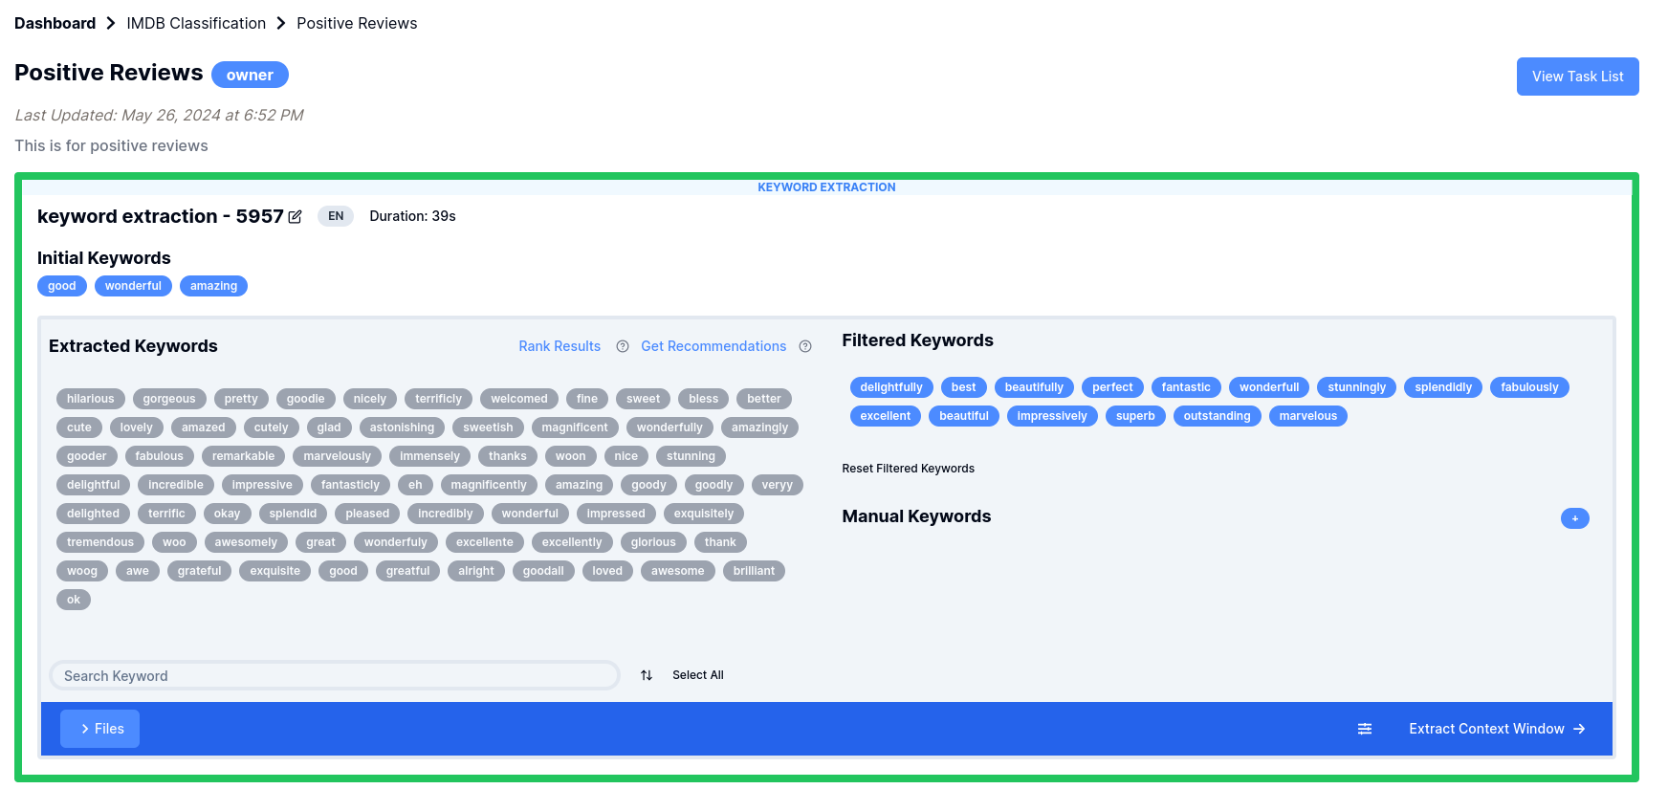
Problems
2. Lacking Collaboration Features:
  Essential collaborative tools and features are absent, hindering teamwork and shared project advancements.
  2.4M rows dataset → 200K extracted context windows across 20 classes.
RQ2.
What mechanisms can be implemented to facilitate seamless collaboration among users working on the same projects?

Slide 12
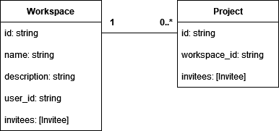
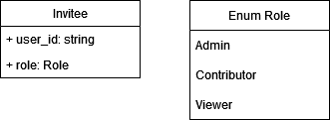
2. Enable Effective User Collaboration
Workspace Management: Integrating workspaces and users' roles
  Controlling users access to workspaces/projects based on roles
project 1
workspace
project
project 2
or

Slide 13
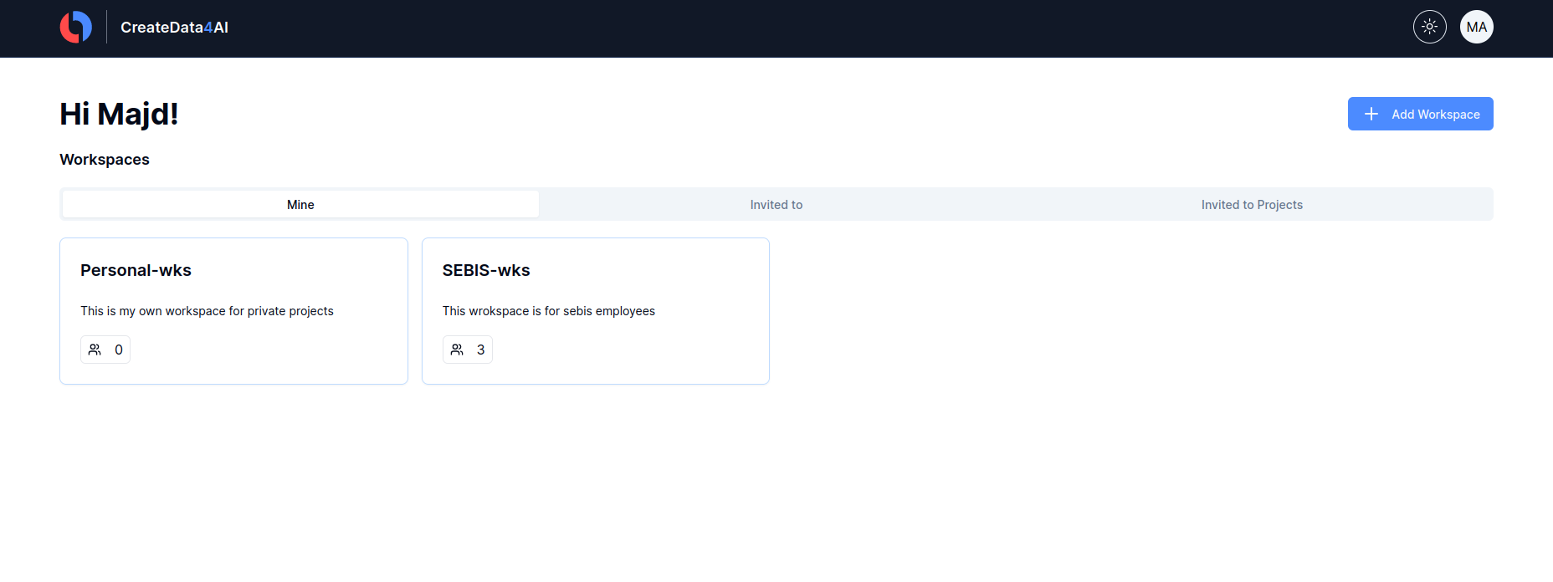
Current Progress Of The Collaboration Feature
SEBIS Worksapce
3 users are invited

Slide 14
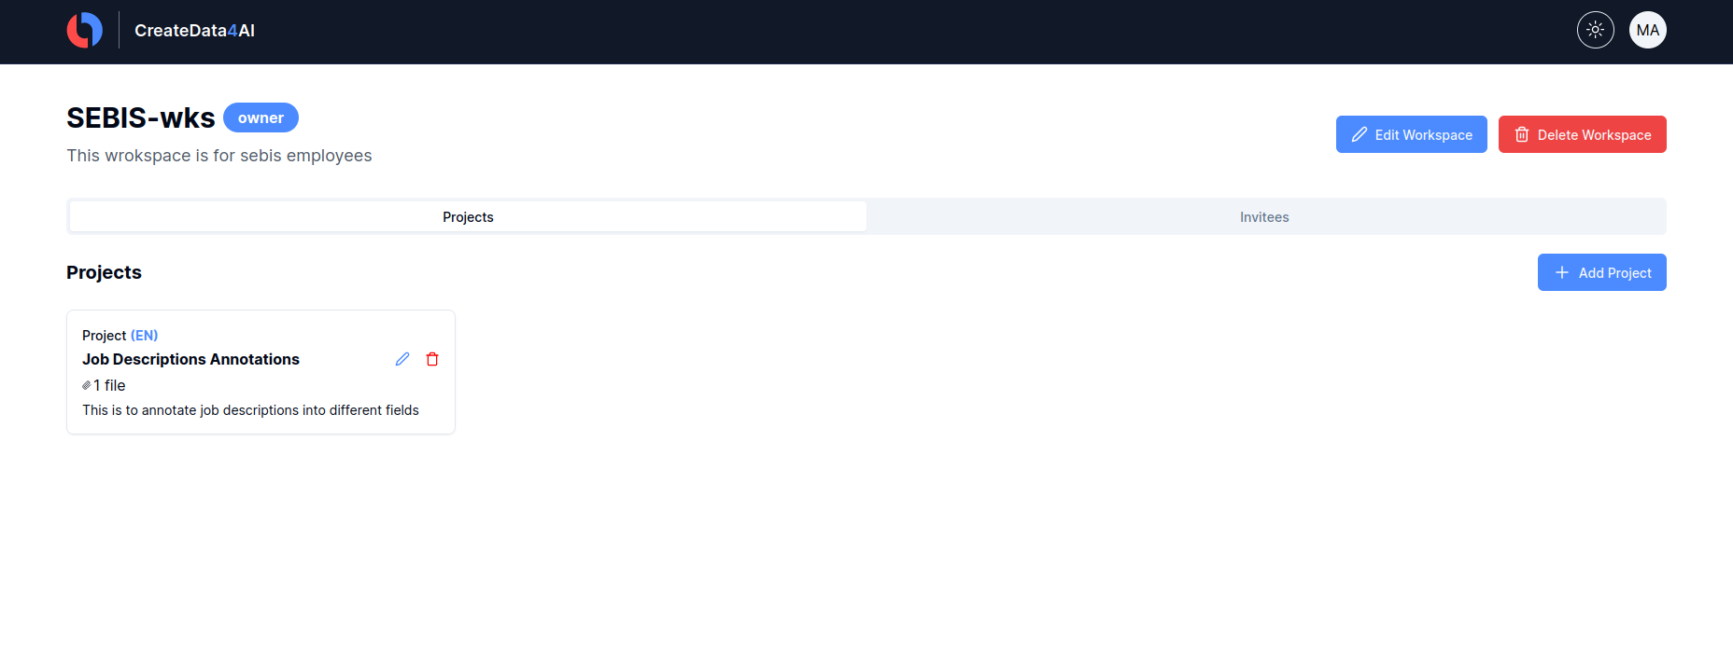
Current Progress Of The Collaboration Feature

Slide 15
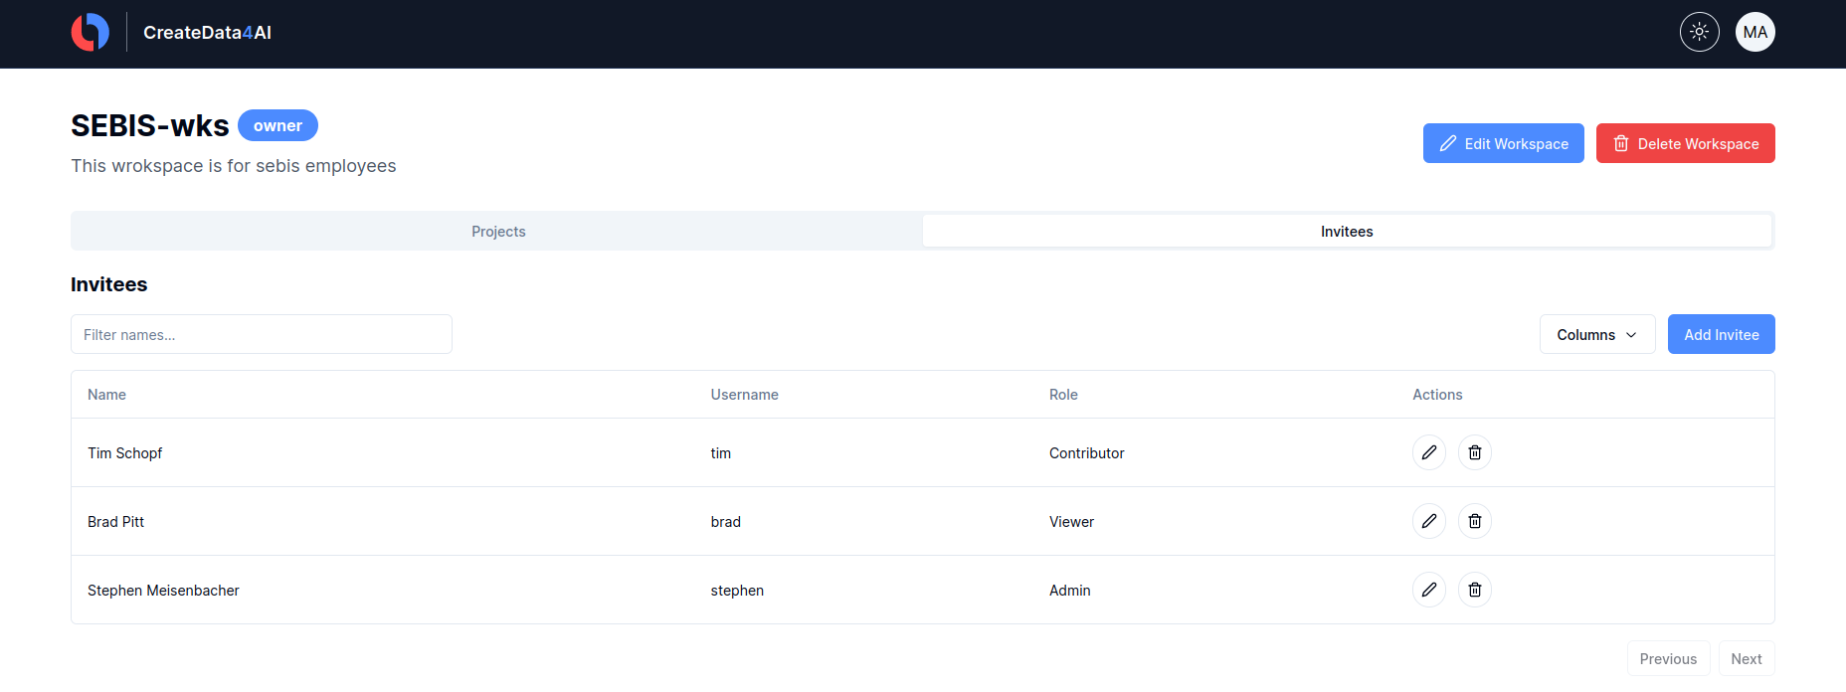
Current Progress Of The Collaboration Feature
Invitee list

Slide 16
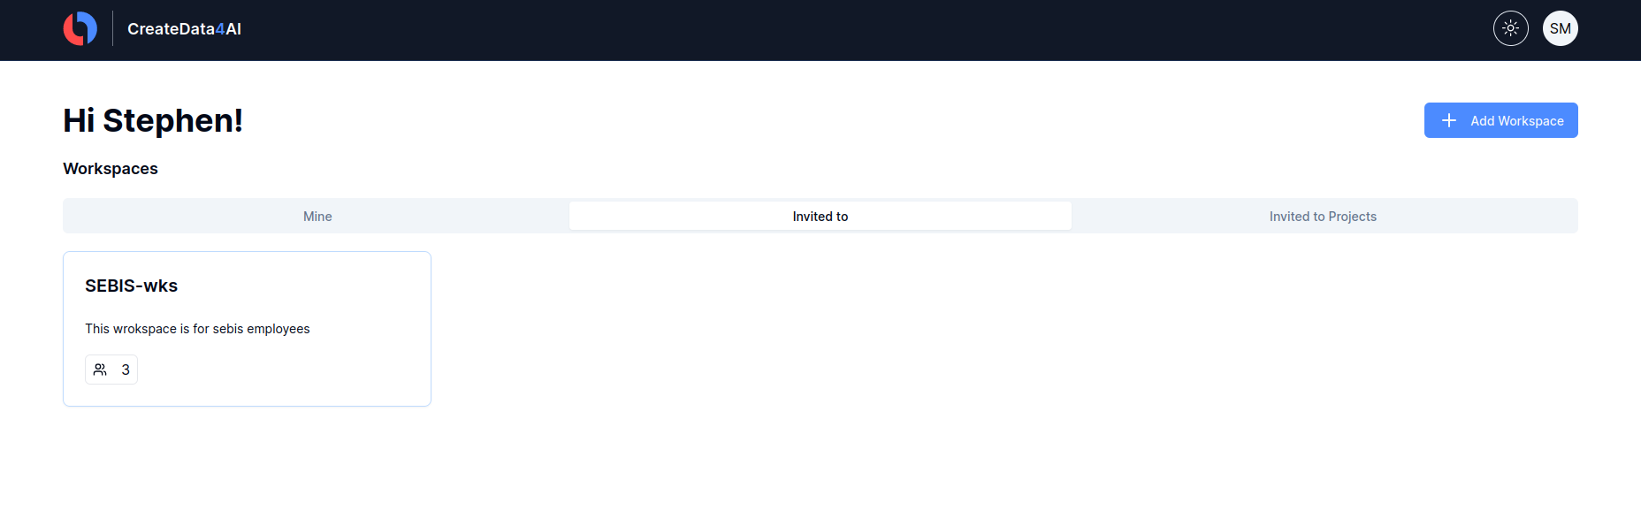
Current Progress Of The Collaboration Feature
Workspaces Stephen got invited to

Slide 17
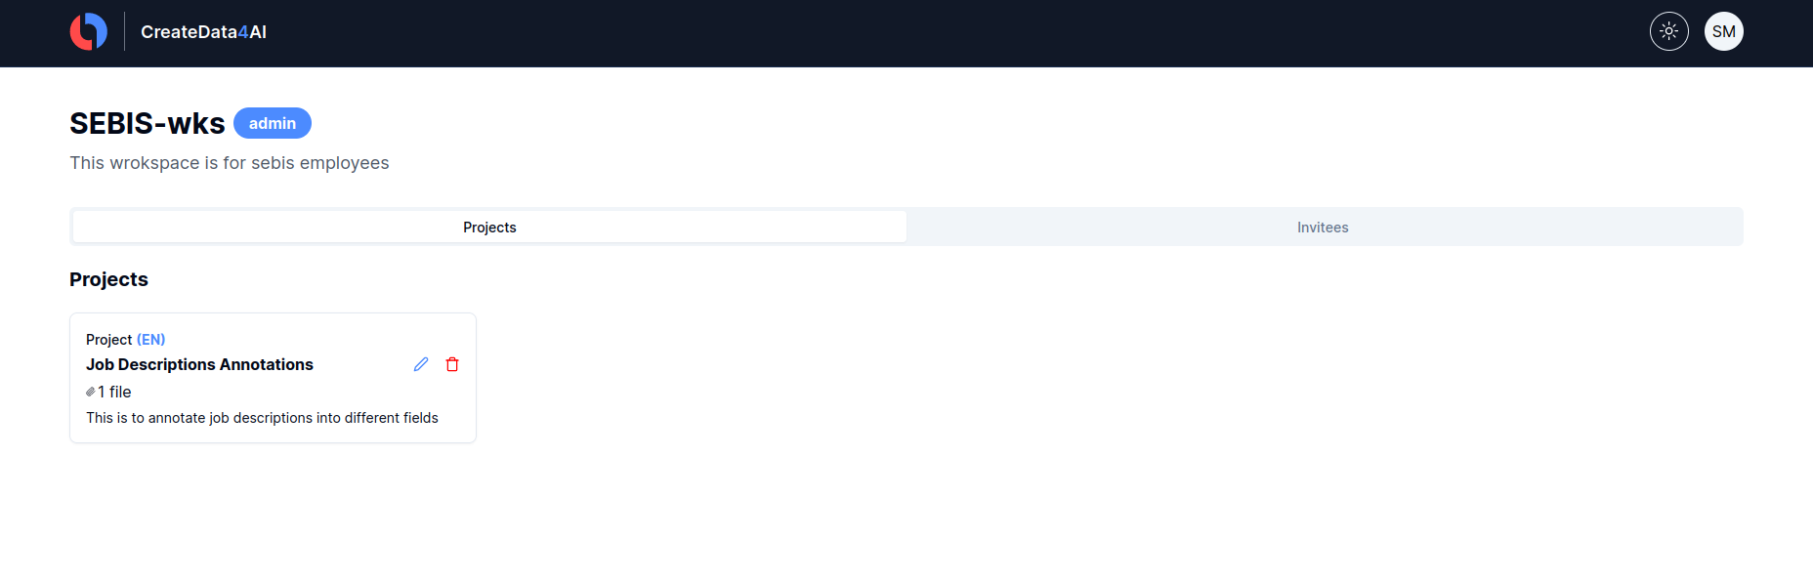
Current Progress Of The Collaboration Feature
Admin role SEBIS workspace
Admin
Almost like the owner

Slide 18
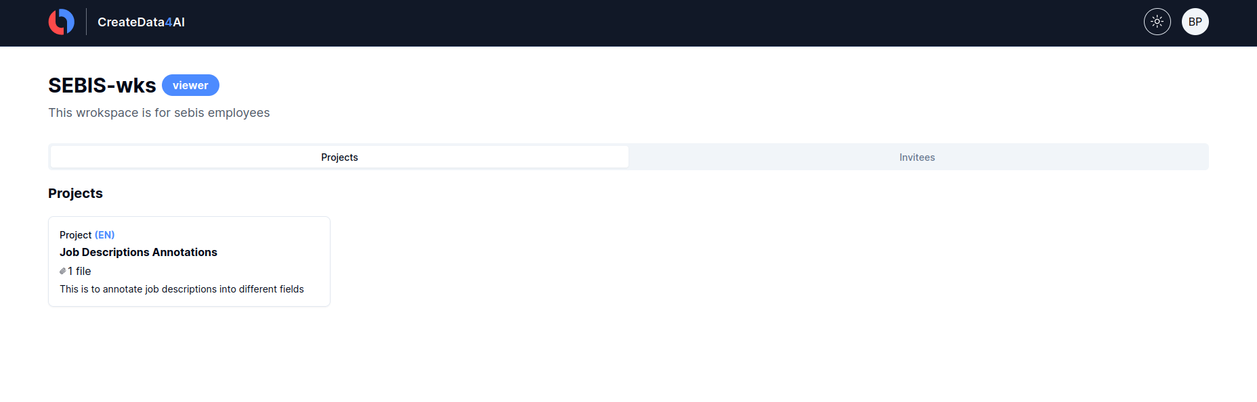
Current Progress Of The Collaboration Feature
Viewer role SEBIS workspace
Viewer
only view and download the results (No CRUD)

Slide 19




2. Enable Effective User Collaboration
Real-time collaboration (Task Level):
Allowing users to help each other in keywords and context windows selections
working with WebSocket for network communication
working with AutoMerge for merging tasks’ state on all devices
Keywords selection

Slide 20
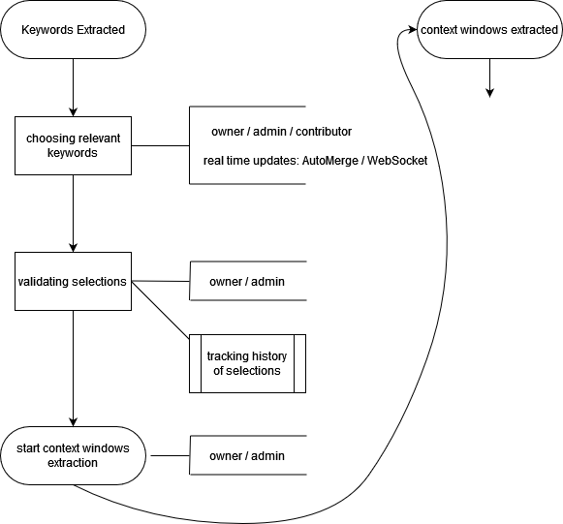
2. Enable Effective User Collaboration
Keywords selection collaboration flow chart:

Slide 21
Next Steps
Optimization Part:
Utilize Parallel Processing:
  Implement parallel processing techniques to accelerate embedding calculations.
  Running keywords extraction task and context window extraction task for all classes at once.
Context Window Extraction Optimization:
  Investigate inefficiencies in the context window extraction process.
  Implement solutions to resolve these inefficiencies.
Collaboration Part:
Merge Conflict Resolution:
  Analyze potential merging conflicts and formulate a policy to address them, including assessing the necessity of an AutoMerge feature.
Implement Real-Time Collaboration
Selection History Tracking:
  Work on mechanisms to track the history of selections for better transparency and accountability.

Slide 22
Project Timeline
 | Apr |  |  |  | May |  |  |  | June |  |  |  | July |  |  |  | Aug |  |  |  | Sept
 | 1 | 2 | 3 | 4 | 1 | 2 | 3 | 4 | 1 | 2 | 3 | 4 | 1 | 2 | 3 | 4 | 1 | 2 | 3 | 4 | 1 | 2 | 3 | 4
Research and technologies discovery
Kickoff presentation
Tasks optimization
Collaboration feature
Code cleanup / Documentation
Final Presentation

Slide 23
Majd Alkayyal
17132
matthes@in.tum.de

Slide 25
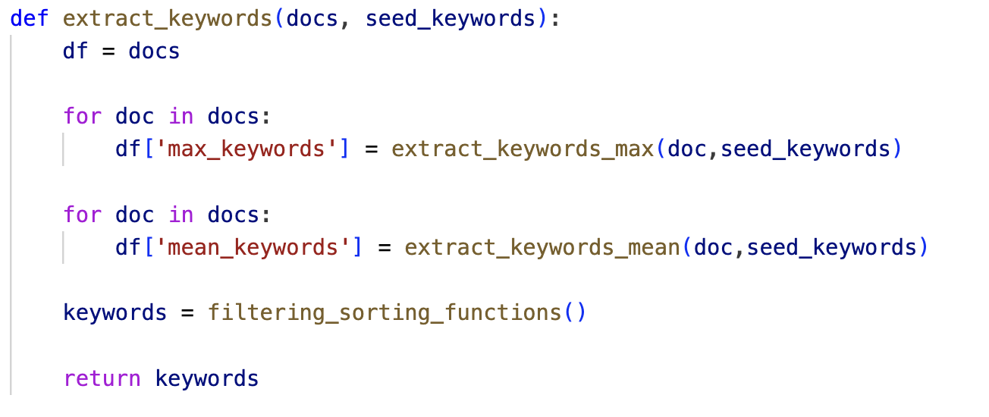
Keyword Extraction Issues

Slide 26
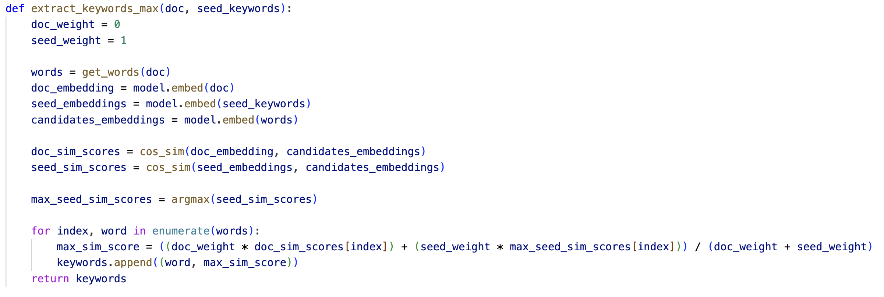
Keyword Extraction Issues

Slide 27
 | CPU | GPU
10k docs | old impl: 01:42:35 new impl: 00:00:58 | old impl: 00:38:06 new impl: 00:00:20
100k docs | old impl: 17:05:50 new impl: 00:05:31 | old impl: 06:21:00 new impl: 00:02:08

Slide 28
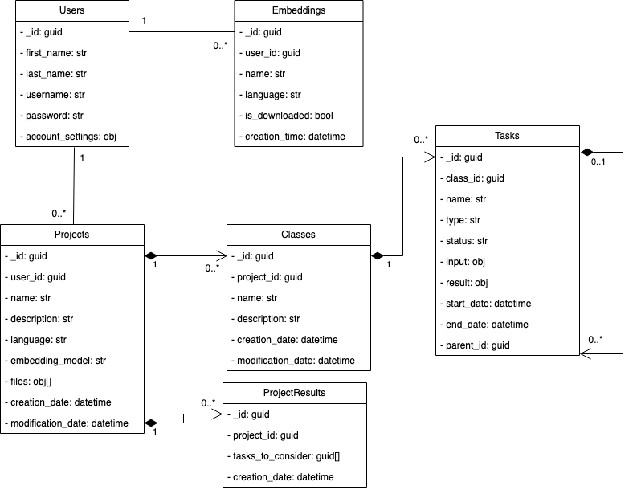
DB Model

